Slide 1

VaporLies
Students from the Liberty University Public Health Association
partnered with providers from the Centra Health Alan B. Pearson Regional Cancer Center

Slide 2
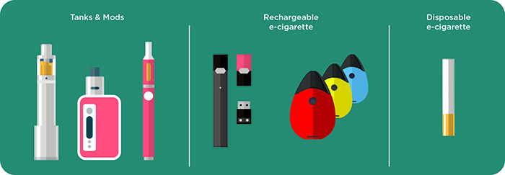
What are E-cigarettes?
Battery powered cigarettes that contain nicotine and other harmful chemicals¹ that turn into vapor
Some e-cigarettes do not produce visible vapor
There are many different designs and flavors (mango, peach, cotton candy, etc.)
https://www.cdc.gov/tobacco/basic_information/e-cigarettes/about-e-cigarettes.html
Notes:
Different types: tanks & mods, rechargeable, and disposable
Has anyone heard of nicotine before? What have you heard about it?
Can anyone tell me why its bad for you?

Slide 3
Why is nicotine bad for you?
Nicotine is an addictive substance found in all cigarette and tobacco products²
Nicotine can cause:
Dizziness
Bad dreams or nightmares
Increased blood pressure
Impaired brain development
Notes:
Can someone tell me what addictive means?
“Addiction is a term that means compulsive physiological need for and use of a habit-forming substance (like heroin or nicotine)”
Hesse M. What does addiction mean to me. Mens Sana Monogr. 2006;4(1):104–126. doi:10.4103/0973-1229.27609

Slide 4

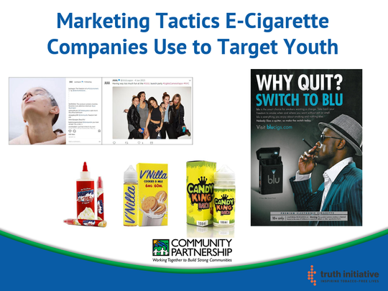

https://www.vox.com/2019/1/25/18194953/vape-juul-e-cigarette-marketing
Photo: Submitted by Scott Allen with CPO
Notes:
How many of you guys have seen these ads before or something similar? (Ask the class)
Where has someone scene a picture like this before? (Ask class)
The images that look like candy are actually e-liquid refills for e-cigarettes
Juul is a well-known brand of a type of e cigarette. Even though Juul no longer has advertisements directed at kids and deactivated their Instagram, some companies still target young kids.

Slide 5


Why are e-cigarette companies targeting YOU?
The companies are trying to trick you into using their products³
By using e-cigarettes at a younger age, you're more likely to use cigarettes and other tobacco products when you get older⁴
Notes:
Tobacco companies own many e-cigarettes and Juul products

Slide 6
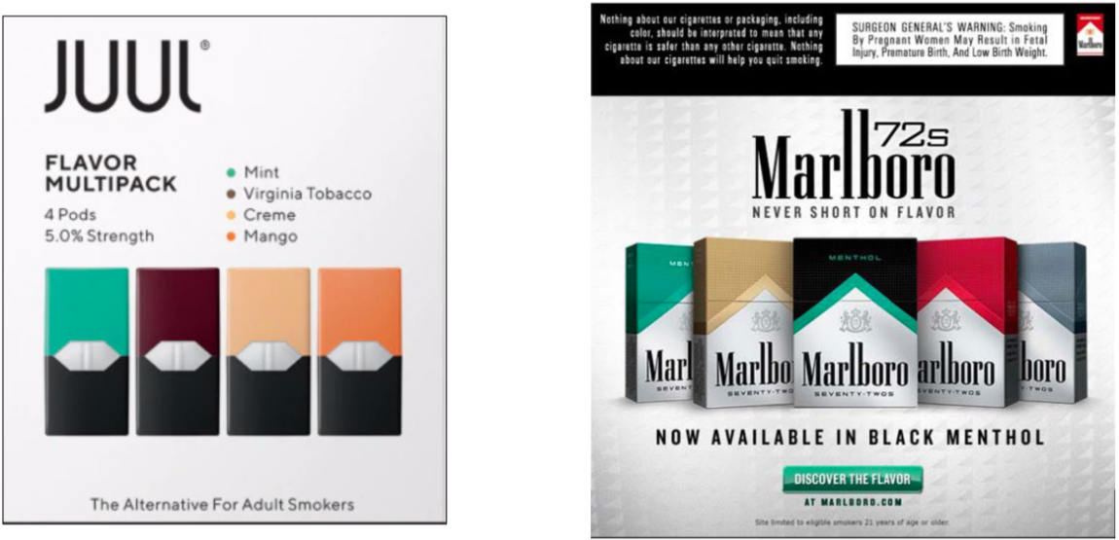
Do they look similar?
https://www.vox.com/2019/1/25/18194953/vape-juul-e-cigarette-marketing
Notes:
Can anyone tell me what's in this picture?
Left picture – e-cigarettes pods; Right picture – normal cigarette packs
Did you know that smoking one JUUL pod is the same as smoking 1 pack of cigarettes?

Slide 7
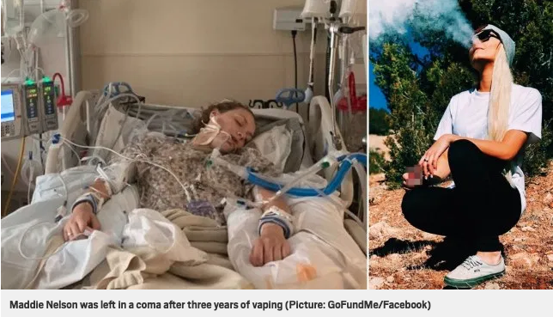
Vaping by the Numbers
In the United States⁴:
  2,172 cases with people who have a lung disease because of vaping
  79% of these patients are younger than 35 years of age
  42 deaths
In Virginia⁵:
  80 cases with people who have a lung disease because of vaping
  1 death
https://www.bnreport.com/teenager-left-in-coma-after-developing-lung-disease-from-vaping/
Notes:
*Maddie Nelson (in picture)
placed in a medically induced coma to treat her eosinophilic pneumonia (she was basically very sick from vaping)
Her condition went from being serious to potentially fatal
**Statistics as of November 12, 2019
Talk a little bit about current news stories
San Francisco banned the sale of all e-cigarettes, Michigan and New York have banned all flavored e-ciggs.

Slide 8

Vaping is Expensive!
JUUL devices: $35
  JUUL pod 4 pack: $15
Other e-cigarette devices: $50 to $300
Average amount spent on e-cigarette products: $50-$75 a month⁶
Notes:
What would you guys buy if you had that much money?

Slide 9
So, how does “VaporLie” ?
VAPOR LIES:
That it’s harmless because of the design and technology^{1,7}
That it looks cool so it can't be bad for you³
That vaping is safer than traditional cigarettes and tobacco products⁴

Slide 10
References
Etter JF, Bullen C, Flouris AD, Laugesen M, Eissenberg T. Electronic nicotine delivery systems: a research agenda. Tob Conrol. 2011;20(3):243-248.doi:10.1136/tc.2010.042168
Lyon PC. Electronic cigarettes: human health effects. Tob Control. 2014;23:ii36-ii40.doi:10.1136/tobaccocontrol-2013-051470
Lauriello S, Lauriello S. Utah Teen Put in Coma After Vaping Every Day for 3 Years. Health.com. https://www.health.com/smoking/utah-teen-coma-vaping-eosinophilic-pneumonia. Published September 3, 2019. Accessed October 15, 2019.
Outbreak of Lung Injury Associated with E-Cigarette Use, or Vaping. Centers for Disease Control and Prevention. https://www.cdc.gov/tobacco/basic_information/e-cigarettes/severe-lung-disease.html. Accessed October 15, 2019.
Virginia Department of Health. Virginia Department of Health: To protect the health and promote the well-being of all people in Virginia. http://www.vdh.virginia.gov/vdhlivewell/vaping/. Published 2019. Accessed November 18, 2019.
Sears C, Hart J, Walker K, Lee A, Keith R, Ridner S. A Dollars and "Sense" Exploration of Vape Shop Spending and E-cigarette Use. Tob Prev Cessat. 2016;2(Suppl):9. doi:10.18332/tpc/67435
Willett JG, Bennett M, Hair EC, Xiao H, Greenberg MS, Harvey E, Cantrell J, Vallone D. Recognition, use and perceptions of JUUL among youth and young adults. BMJ. 2018;28(1).doi:10.1136/tobaccocontrol-2018-054273

